Slide 1
Juggling life and learning
Barbara Oakley, PhD

Slide 2
Weekly list of key tasks
Daily “to do” list

Slide 3
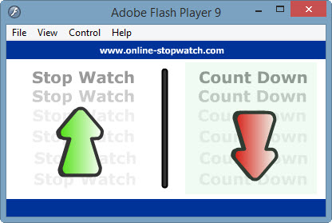
Plan your quitting time!

Slide 4

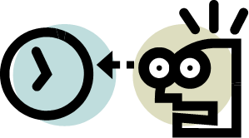

Slide 5
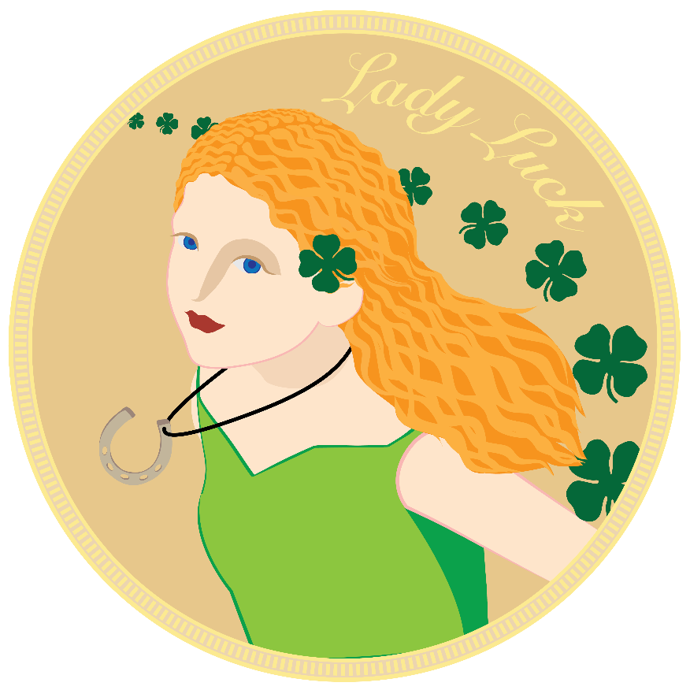
The Law of Serendipity
Lady Luck favors the one who tries.

Slide 6
Image Credits
Zombie task list ©Kevin Mendez, 2014.
Online stopwatch, http://www.online-stopwatch.com/.
Clip art courtesy Microsoft Corporation
Relevant Readings
Boice, Robert. Procrastination and Blocking. Westport, CT: Praeger, 1996.
Duhigg, Charles. The Power of Habit. NY: Random House, 2012.
Fiore, Neil A. The Now Habit. NY: Penguin, 2007.
McClain, Dylan Loeb. "Harnessing the Brain's Right Hemisphere to Capture Many Kings." New York Times, Jan 24 2011.
Newport, Cal. How to Become a Straight-a Student: The Unconventional Strategies Real College Students Use to Score High While Studying Less. New York, NY: Random House, 2006.
———. So Good They Can't Ignore You. NY: Business Plus, 2012.
Scullin, M. K., and M. A. McDaniel. "Remembering to Execute a Goal: Sleep on It!" Psychological Science 21, no. 7 (Jul 2010): 1028-35.
Steel, Piers. "The Nature of Procrastination: A Meta-Analytic and Theoretical Review of Quintessential Self-Regulatory Failure." Psychological Bulletin 133, no. 1 (Jan 2007): 65-94.
———. The Procrastination Equation. NY: Random House, 2010.
Wan, X., H. Nakatani, K. Ueno, T. Asamizuya, K. Cheng, and K. Tanaka. "The Neural Basis of Intuitive Best Next-Move Generation in Board Game Experts." Science 331, no. 6015 (Jan 21 2011): 341-6.

